Slide 1
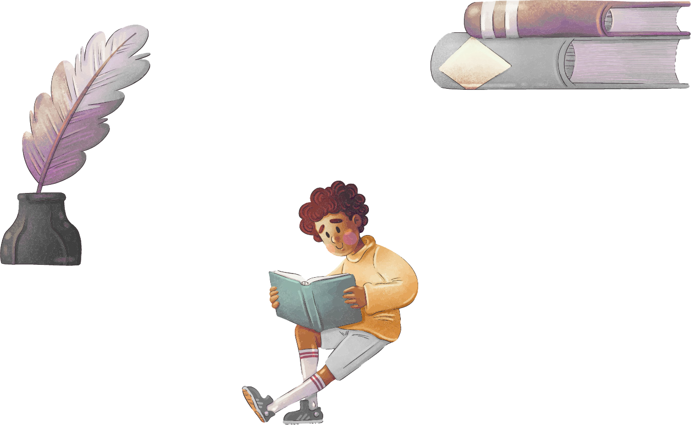
LANGUAGE ARTS SUBJECT FOR ELEMENTARY
african american poetry
4th grade
Here is where your presentation begins

Slide 2
Contents of this template
This is a slide structure based on a education presentation
You can delete this slide when you’re done editing the presentation
Fonts | To view this template correctly in PowerPoint, download and install the fonts we used
Used and alternative resources | An assortment of graphic resources that are suitable for use in this presentation
Thanks slide | You must keep it so that proper credits for our design are given
Colors | All the colors used in this presentation
Infographic resources | These can be used in the template, and their size and color can be edited
Customizable icons | They are sorted by theme so you can use them in all kinds of presentations
For more info: SLIDESGO | SLIDESGO SCHOOL | FAQS
You can visit our sister projects: FREEPIK | FLATICON | STORYSET | WEPIK | VIDFY

Slide 3
Table of contents
Theory
Popular poems
01
02
Activities
Summary
03
04
You can describe the topic of the section here
You can describe the topic of the section here
You can describe the topic of the section here
You can describe the topic of the section here

Slide 4

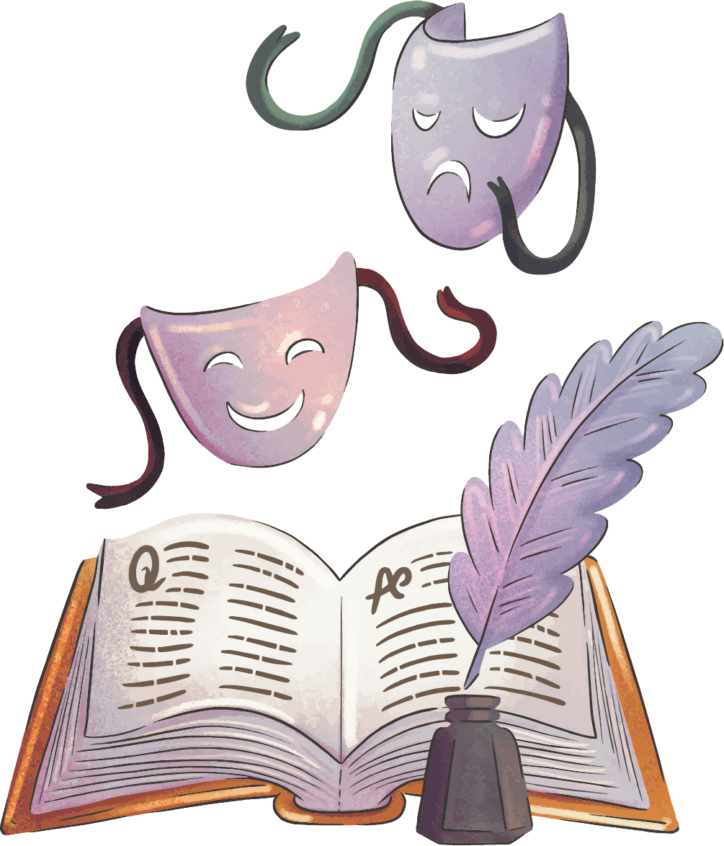
WHOA!
This can be the part of the presentation where you introduce yourself, write your email…

Slide 5
01
Theory about poems
You can enter a subtitle here if you need it

Slide 6

The slide title goes here!
Do you know what helps you make your point clear? Lists like this one:
They’re simple
You can organize your ideas clearly
You’ll never forget to buy milk!
And the most important thing: the audience won’t miss the point of your presentation

Slide 7
Verses and stanzas
Verses
Stanzas
Mercury is the closest planet to the Sun and the smallest one in the Solar System—it’s only a bit larger than the Moon
Venus has a beautiful name and is the second planet from the Sun. It’s hot and has a poisonous atmosphere

Slide 8

Types of rhymes
Mars
Mercury
Venus
Despite being red, Mars is actually a cold place. It’s full of iron oxide dust
It’s the closest planet to the Sun and the smallest one in the Solar System
Venus has a beautiful name and is the second planet from the Sun

Slide 9
Steps to understand a poem
Mars
Venus
01
02
Jupiter
Saturn
03
04
Mars is actually a very cold place
Venus has extremely high temperatures
It’s the biggest planet in the Solar System
Saturn is a gas giant and has several rings

Slide 10
Elements of poetry
Mars
Venus
Neptune
Mercury
Saturn
Jupiter
Mars is actually a very cold place
Venus has extremely high temperatures
Neptune is the farthest planet from the Sun
It’s the closest planet to the Sun
Saturn is a gas giant with several rings
Jupiter is the biggest planet of them all

Slide 11
—Someone famous
“This is a quote, words full of wisdom that someone important said and can make the reader get inspired.”

Slide 12
A picture always reinforces the concept
Images reveal large amounts of data, so remember: use an image instead of a long text. Your audience will appreciate it

Slide 13
Percentage of poems read
25%
50%
75%
Mercury
Venus
Mars
It’s the closest planet to the Sun and the smallest one in the Solar System
Venus has a beautiful name and is the second planet from the Sun
Despite being red, Mars is actually a cold place. It’s full of iron oxide dust

Slide 14
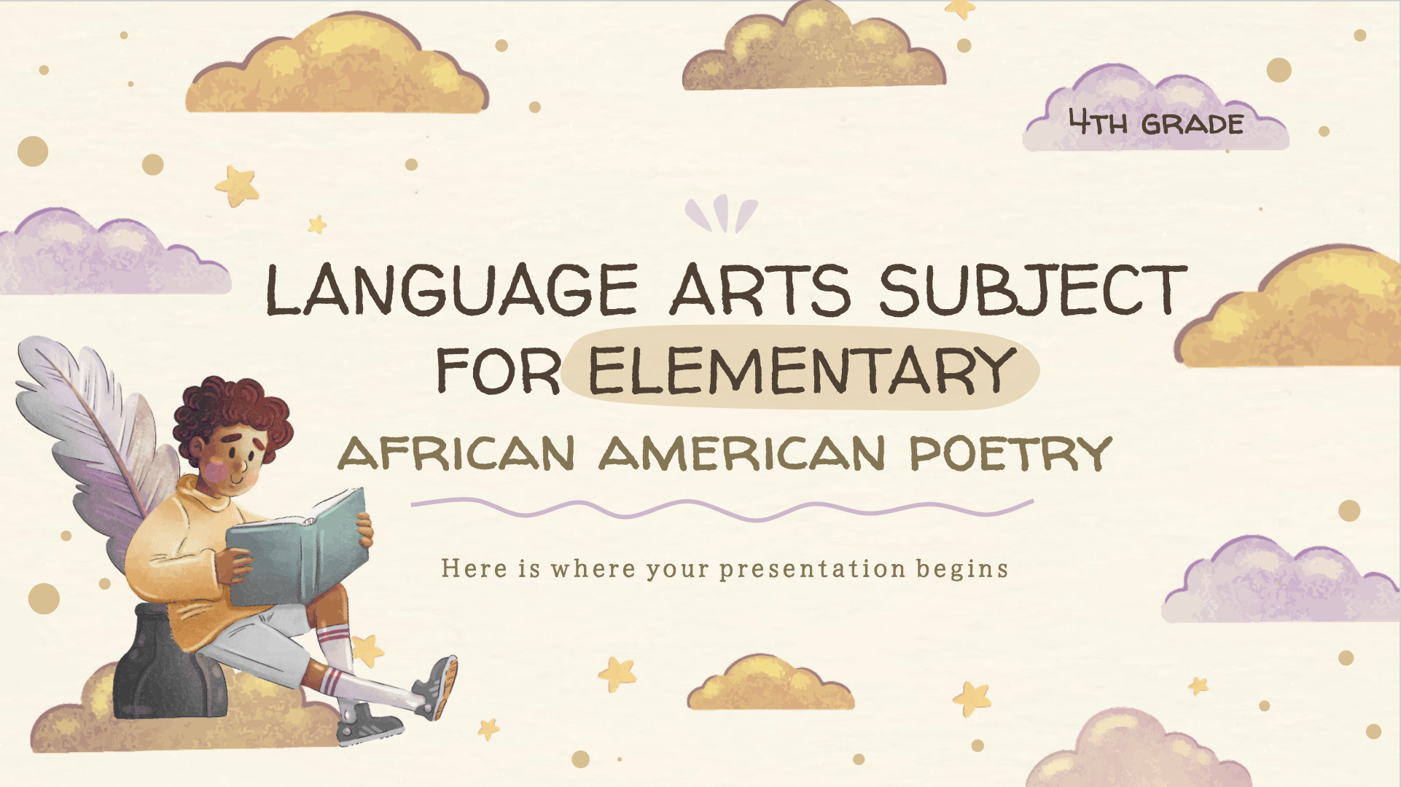
Computer mockup
You can replace the image on the screen with your own work. Just right-click on it and select “Replace image”

Slide 15
Tablet mockup
You can replace the image on the screen with your own work. Just right-click on it and select “Replace image”

Slide 16
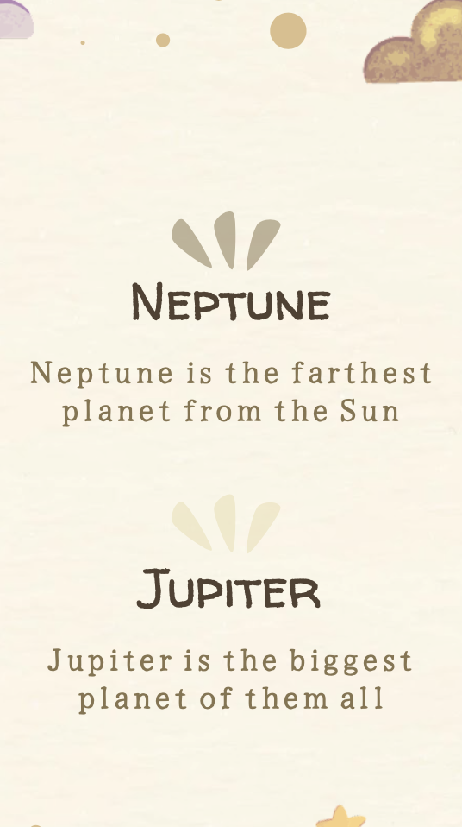
Phone mockup
You can replace the image on the screen with your own work. Just right-click on it and select “Replace image”

Slide 17
Timeline of poetry activities
Venus is the second planet from the Sun
Despite being red, Mars is a very cold place
Day 1
Day 3
Day 2
Day 4
Mercury is the closest planet to the Sun
Jupiter is the biggest planet of them all

Slide 18
Origin of the poetry
Venus
Venus is the second planet from the Sun
Mercury
Mercury is the closest planet to the Sun
Mars
Despite being red, Mars is a very cold place

Slide 19

Structure of a poetry
Stanza
Meter
Mars is actually a very cold place
Venus has extremely high temperatures
Rhyme
Line break
It’s the closest planet to the Sun
Saturn is a gas giant and has several rings

Slide 20
Checklist for writing a poem
 | style | message | Write | Correct
POEM 1
POEM 2
POEM 3

Slide 21
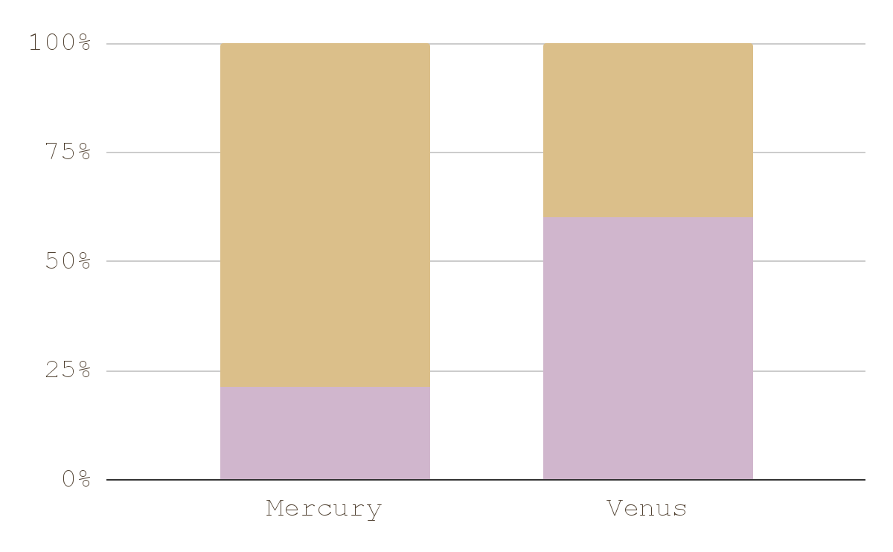
You can use this graph
Venus
Mercury
Venus has very high temperatures
It's the closest planet to the Sun
Follow the link in the graph to modify its data and then paste the new one here. For more info, click here

Slide 22
Reading & responding
Poem title
You can write here...
Venus has a beautiful name and is the second planet from the Sun
It’s terribly hot, even hotter than Mercury, and its atmosphere is extremely poisonous
It’s the second-brightest natural object in the night sky after the Moon

Slide 23
Parts of the poem
Poem
Mood
Theme
Rhythm
Meter
Neptune is very far from the Sun
Mars is actually a cold place
Mercury is the smallest planet
Venus has a beautiful name
The feeling
The message
The beat
The style

Slide 24
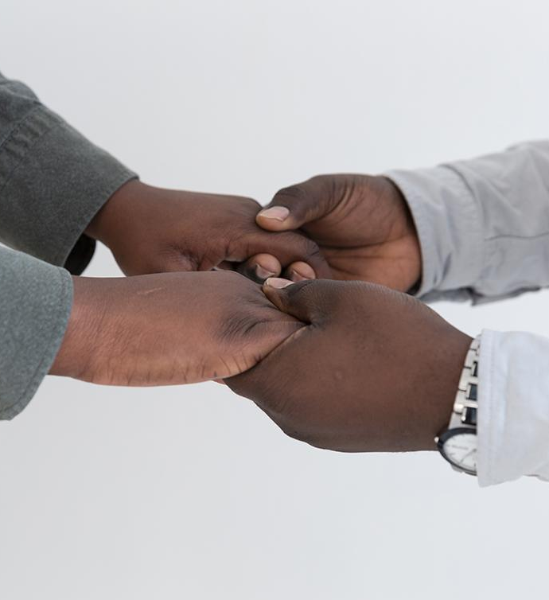
Write a poem about this image
Write here...

Slide 25
Language arts: select the answer
01. What is the theme?
a. Love
b. Friendship
c. Nature
02. Where is the place?
a. Beach
b. Palace
c. Room
03. Who is the character?
a. A boy
b. A girl
c. A bird
04. What is the tone?
a. Nostalgic
b. Romance
c. Sad

Slide 26
Write the parts of the poem
Poem title
Write here...
Venus has a beautiful name and is the second planet from the Sun
This planet is terribly hot, even hotter than Mercury, and its atmosphere is extremely poisonous
It’s the second-brightest natural object in the night sky after the Moone
Write here...
Write here...
Write here...

Slide 27
Join rhyming words
Neptune
Jupiter
Planet
Mars
Earth
Pluto
Venus
Saturn
Sun
Mercury
Moon
Atmosphere

Slide 28
THANKS
Do you have any questions?
addyouremail@freepik.com
+91 620 421 838
yourwebsite.com
Please keep this slide for attribution

